Slide 1
Red-Black Trees

Slide 2
Definition
A red-black tree is a self balanced binary search tree in which:
Every node is colored either Red or Black.
Each NULL pointer is considered to be an external node.
Following four properties holds:
Root Property – The root is black.
Internal Property – The children of a red node are black.
External Property - Every leaf (external node) is black.
Depth Property – Black-Depth of all external nodes is same.
.

Slide 3
Is this a Red-Black Tree?

Slide 4
Is this a Red-Black Tree?

Slide 5
Is this a Red-Black Tree?
NIL
NIL
NIL
NIL

Slide 6
Is this a Red-Black Tree?
19
12
35
50
0
75
-10
-5
135
-8
100
-6
80

Slide 7
Insertion Operation
G
G
P
U
P
U
X
X
Let x be the newly inserted node.
1) Perform standard BST insertion and make the color of newly inserted nodes as RED.
2) If x is root, change color of x as BLACK .
3) Do following if color of x’s parent is not BLACK or x is not root.
a) If x’s uncle is RED
Change color of parent and uncle as BLACK.
Color of grand parent as RED.
Change x = x’s grandparent, repeat steps 2 and 3 for new x.

Slide 8
Insertion Operation (Contd.,)
b) If x’s uncle is BLACK,
Perform a trinode restructuring
Take node x, its parent p, and grandparent g, and temporarily relabel them as a, b, and c, in left-to-right order, so that a, b, and c will be visited in this order by an inorder tree traversal.
Replace the grandparent u with the node labeled b, and make nodes a and c the children of b, keeping inorder relationships unchanged.
Color b black, and color a and c red.

Slide 9
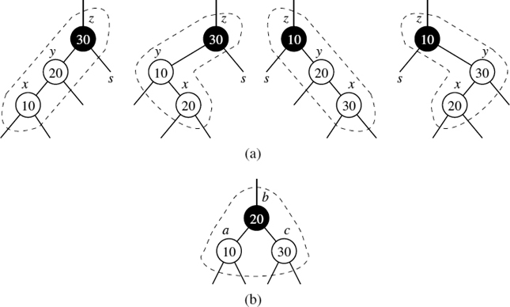
Trinode Restructuring

Slide 10
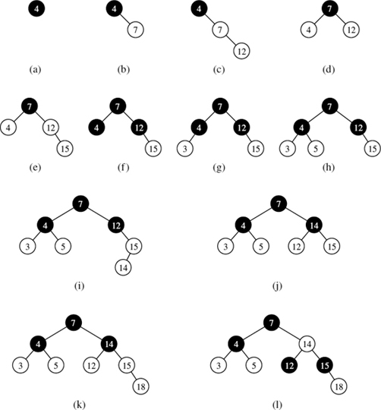

Slide 11
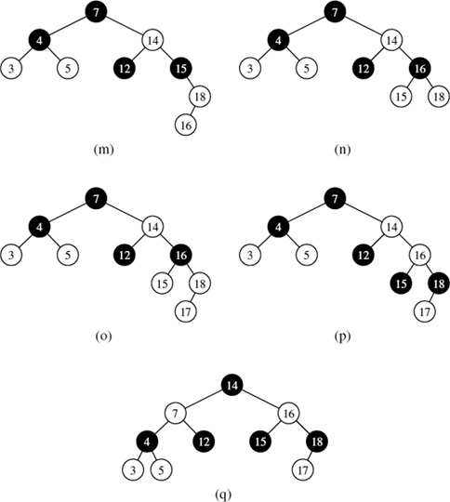

Slide 12
Practice Problem
Insert 2, 1, 4, 5, 9, 3, 6, 7

Slide 13
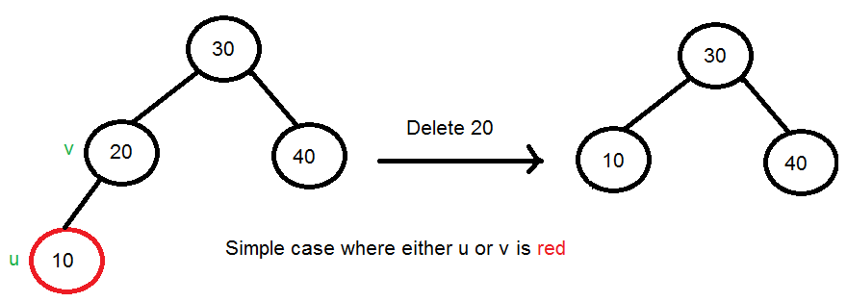
Deletion Operation
Deletion Algorithm
Perform standard BST delete. Let v be the node to be deleted and u be the child that replaces v.
Simple Case: If either u or v is red, mark the replaced child as black.

Slide 14
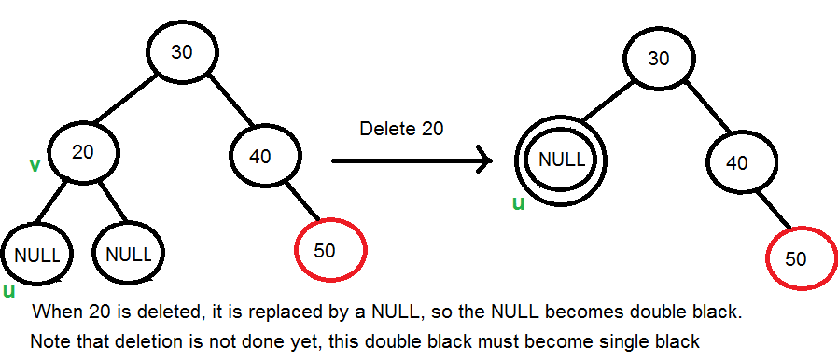
Deletion Operation
If Both u and v are Black.
3.1 Color u as double black. Now the task reduces to convert this double black to single black. (Note that If v is leaf, then u is NULL and color of NULL is considered as black. So the deletion of a black leaf also causes a double black.)

Slide 15
Deletion Operation
3.2 Do following while the current node u is double black and it is not root. Let sibling of node be s.
(a) If sibling s is black and at least one of sibling’s children z is red, perform a trinode restructuring
Take the node z, its parent s, and grandparent x, labels them temporarily left to right as a, b, and c, and replace x with the node labeled b, making it the parent of the other two.
Color a and c black, give b the former color of x, and color u black

Slide 16
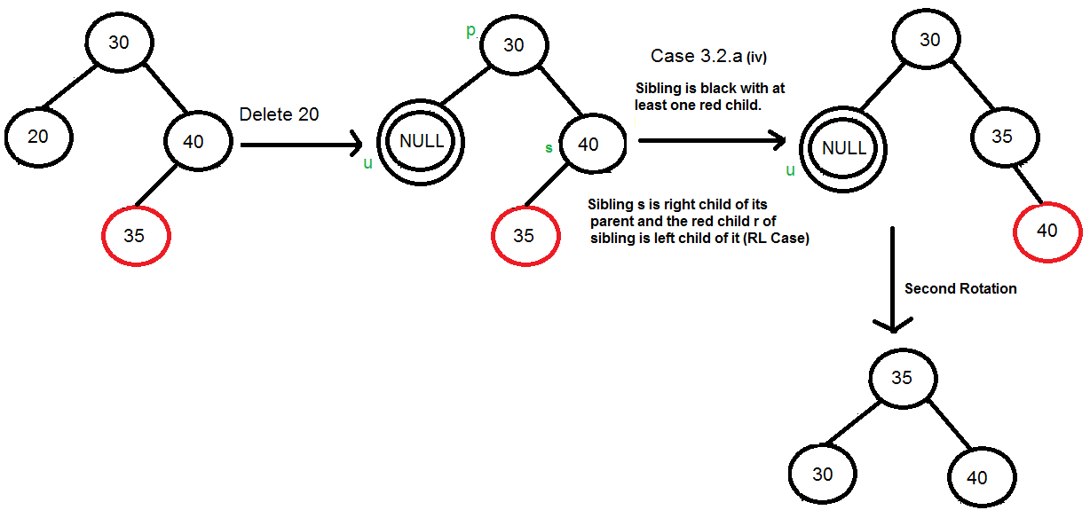
Right Left Case Example

Slide 17
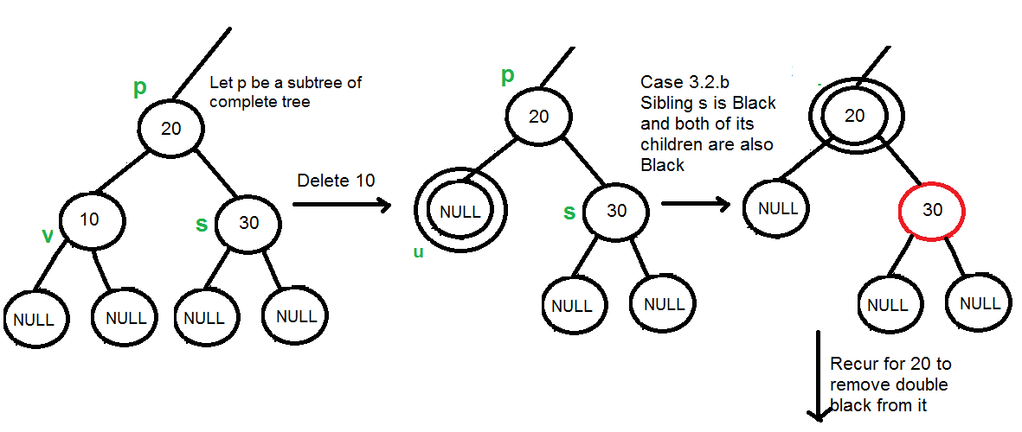
Deletion Operation
3.2. (b) If sibling is black and its both children are black, perform recoloring, and recur for the parent if parent is black.

Slide 18
Deletion Operation
3.2. (c) If sibling is red, perform a rotation to move old sibling up, recolor the old sibling and parent. This leads to case 3.2 (a) or 3.2 (b). This case can be divided in two subcases.
(i) Left Case (s is left child of its parent) – Right rotate the parent p. (ii) Right Case (s is right child of its parent) – Left rotate the parent p.
3.3 If u is root, make it single black and return (Black height of complete tree reduces by 1).

Slide 19
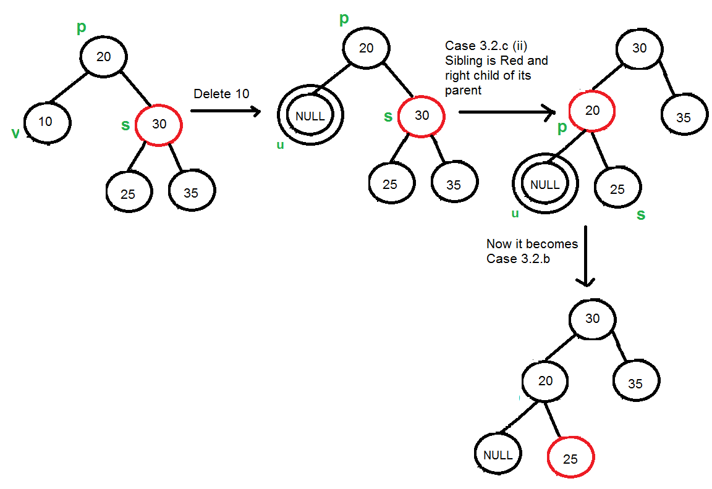
Deletion Operation

